Slide 1

Keyword Analysis
Brought to you by the Gould Library Data Services

Slide 2
Keyword Analysis
In the previous slides, we learned how to handle our text data:
We learned how to bring our text file (csv, xlsx) into our r sciprt/console
We also learned how to pre-process our data. Again, this is the most important process (and also the most time consuming process) that should be taken care of
We also learned how to use our tm package
We learned what TF-IDF and DTM (Document Term Matrix) are
We learned how to visualize text data based on the words frequency level
So far we have learned the basics.
This PowerPoint slide will introduce basic concepts of keyword analysis (one of the most used text mining/text analysis method in the marketing/academic field) that was not covered in the video tutorial

Slide 3
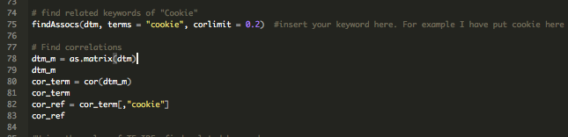
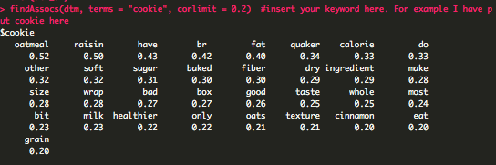
tm Package – Extracting Associated Words
Use the findAssocs function to associated words of a particular word
This is the result you will get

Slide 4
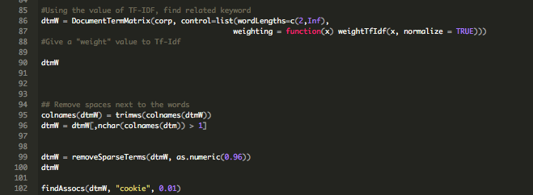
Based on TF-IDF, Extract Associated Words
Finding associated words just by the frequency might lead to a wrong interpretation. Hence, we use the value of TF-IDF to select important associated words and then extract them.

Slide 5
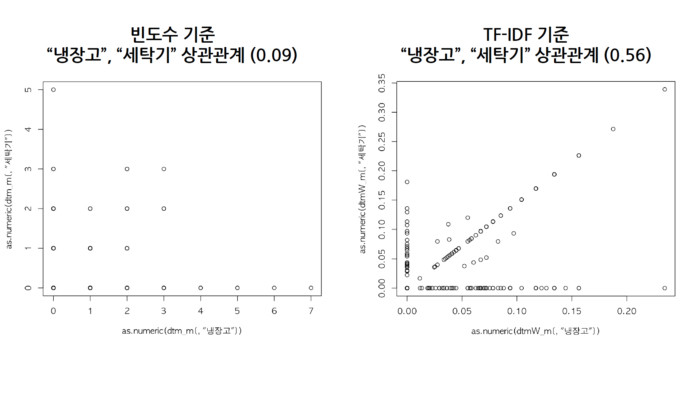
Frequency vs TF-IDF Associated Keywords
Example:
Based on Frequency:
Correlation between Cookies and Oatmeal (0.09)
Based on TF-IDF:
Correlation between Cookies and Oatmeal(0.56)
oatmeal
oatmeal
Cookies
Cookies

Slide 6
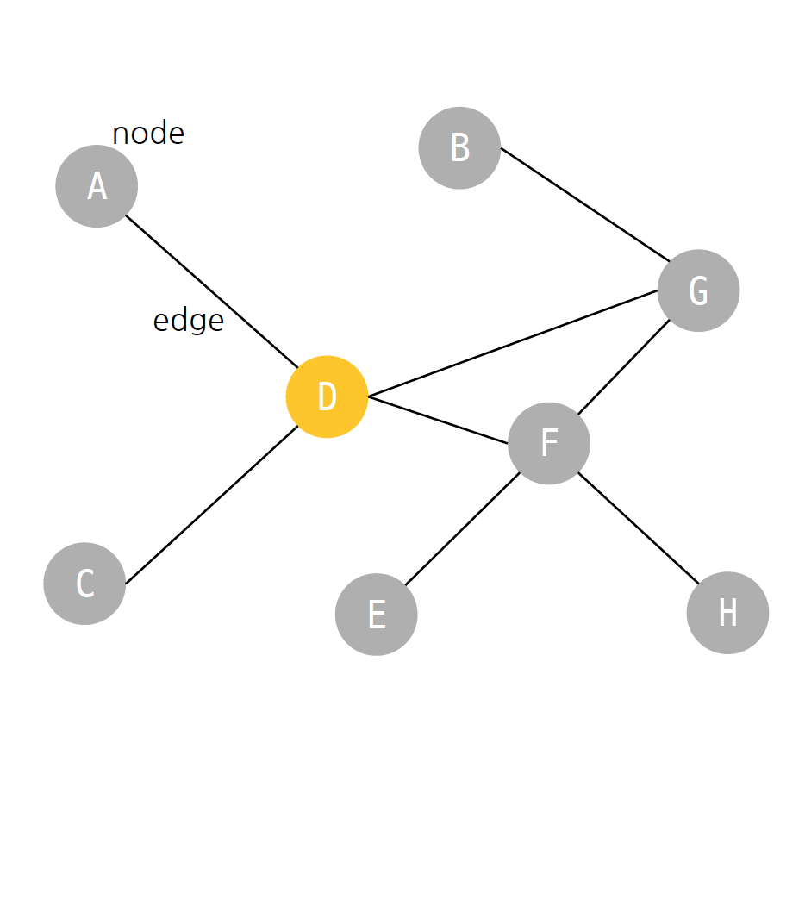
Drawing Associated Keyword Network Map
Degree
The number of edge connected to a node
Degree Centrality
The number/value of links upon a node
Betweeness Centrality
The measure of centrality in a graph based on shortest paths.
D & F’s centrality is the same but D’s betweenness centrality's value is greater

Slide 7
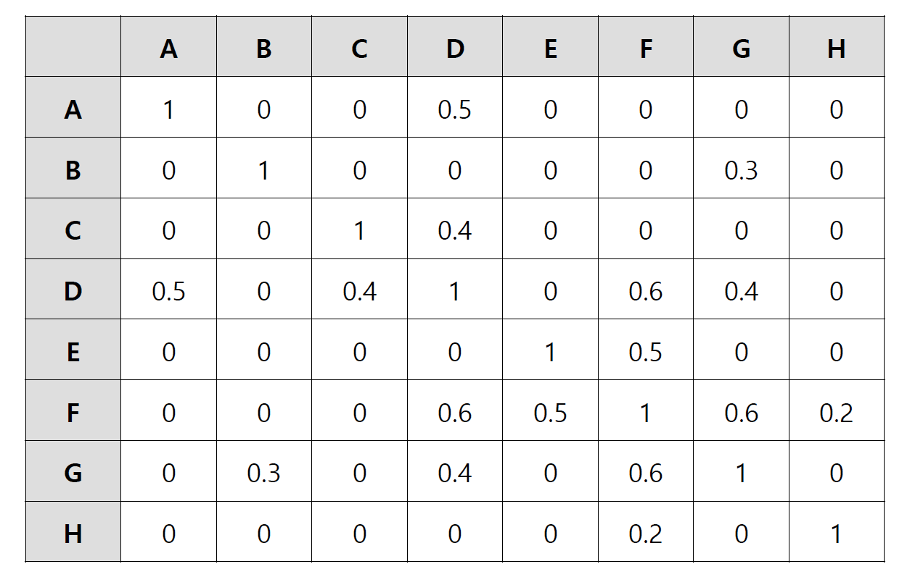
Associated Keyword Network Data Structure
In order to draw a network map, our data structure has to look like this matrix on the left
Each row and column represents the node
Each relationship between the nodes is explained by the number
When the value is 0, an edge will not be created

Slide 8
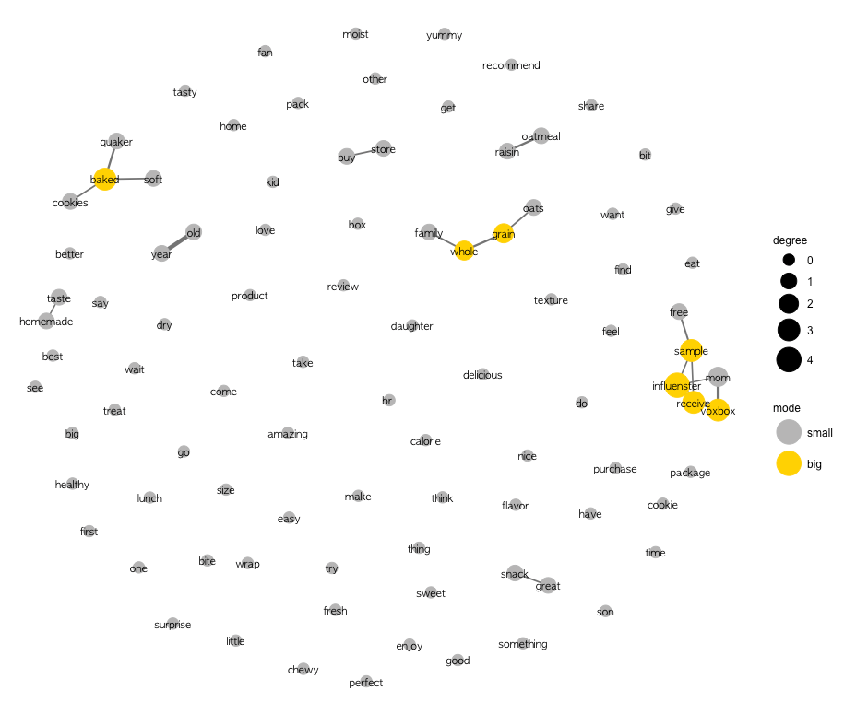
Follow the steps in the r script in order to create this network map

